Slide 1

Lecture 3: How securities are traded
HE Tai-Sen
FINANCIAL ECONOMICS

Slide 2
How securities are traded
Outline
How Securities are traded (3.1, 3.2, 3.5, 3.6, 3.7)
How firms issue securities
How securities are traded
Trading costs, Buying on Margin, Short sales

Slide 3

How securities are traded
How Firms Issue Securities
Primary market vs. Secondary market
Trading in ________ markets does not affect the outstanding amounts of securities.
Why do we need secondary markets? ________
Primary market
Secondary market
Securities
Securities
Firms
the Public
the Public
$$
$$

Slide 4
How securities are traded
How Firms Issue Securities
Primary market
Two types of primary market issues:
Private placements: privately held firms can sell securities to a small group of investors (institutional investors or very wealthy investors). Privately held firms have fewer obligations to release financial statements and other information to the public. However, shares in privately held firms are less liquid (which may reduce their prices).
Public offerings: selling securities to the public
Initial public offerings (IPOs): company's first sale of stocks, bonds or certificates of deposit to the public.
Seasoned equity offerings also known as follow-on equity offerings. Shelf registration allows firms to register securities and gradually sell them to the public for 3 years following the initial registration.
Both public offerings and private placements are usually marketed by investment banks.

Slide 5
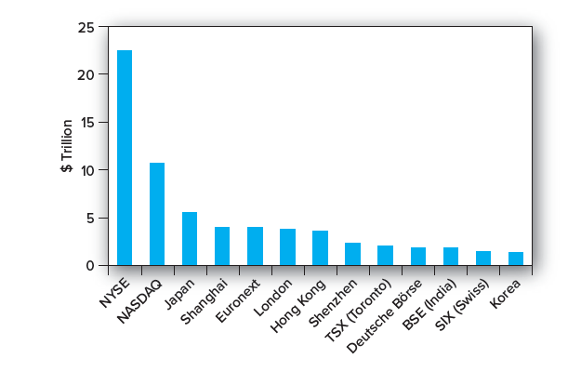
How securities are traded
How Firms Issue Securities
Secondary market
The biggest stock markets in the world by market capitalization in 2018.
Singapore market cap is roughly 650 billion US dollars.
Source: https://www.tradinghours.com/markets

Slide 6
How securities are traded
How Securities Are Traded
When it comes to investing, know “how” to buy and “what” to buy are equally important. In this section, we will discuss the “how” question and use stocks as an example.

Slide 7
How securities are traded
How Securities Are Traded
Types of Orders
Market orders: buy or sell orders that are to be executed immediately at current market prices.
Example: Suppose you want to buy IBM shares. You call your broker who reports back: bid price ($90), ask price ($90.05)
An order to “buy at market” would result in purchased at ______, and an order to “sell at market” would be executed at _______.
90.05
90
Note: Bid price is the highest buying price
Ask price is the lowest selling price

Slide 8
How securities are traded
How Securities Are Traded
Types of Orders
Price-contingent orders
Buy orders
Limit-buy order is an order to purchase an asset at or below a specified price.
Stop-buy order is an order to purchase an asset at or above a specified price.
Sell orders
Limit-sell order is an order to sell an asset at or above a specified price.
Stop-loss order is an order to sell an asset at or below a specified price.

Slide 9
How securities are traded
Trading Costs
Full-service brokers vs. Discount brokers
Full-service brokers provide a variety of services often are referred to as financial consultants or account executives. They routinely provide information and advice relating to investment alternatives.
Discount brokers provide “no-frills” services. Brokerage firms like Schweb and E*Trade offer commissions well below $10.

Slide 10
How securities are traded
Buying on Margin
Buying stocks on margin (known as share financing in Singapore): the investor borrows part of the purchase price of the stock from a broker.
Percentage margin is the ratio of the equity value of the account to the market value of the securities.
Initial margin: the percentage of the purchase price of securities that the investor must pay for with his or her own cash.
Maintenance margin: The minimum amount of equity that must be maintained in a margin account.

Slide 11
How securities are traded
Buying on Margin
How does it work? (refer to Example 3.1)
Initial position
Share price $100
Initial Margin 60%
Maintenance Margin 40%
Shares Purchased 100
Note: they don’t need to add up to 100%.
4000
Stock $10,000 Borrowed $_____
Equity $_____
6000

Slide 12
How securities are traded
Buying on Margin
Stock price falls to $70 per share
Question: How far can the stock price fall before receiving a margin call?
7000
4000
Stock $ ______ Borrowed $_____
Equity $_____
3000
Percentage Margin = $3,000/$7,000 = 43%

Slide 13
How securities are traded
Short Sales
Short Sale: an investor borrows a share of stock from a broker and sells it. Later, the short-seller must purchase a share of the same stock to replace the share that was borrowed.
How to profit from a decline in the price of a stock or security?
Borrow stock through a broker.
Sell it and deposit proceeds and margin in an account.
Closing out the position: buy the stock and return to the party from which it was borrowed.

Slide 14
How securities are traded
Short Sales
How does it work? (refer to Table 3.5)
Dot Bomb 1000 Shares
Initial Margin 50%
Maintenance Margin 30%
Initial Price $100
Initial position
Assets
$100,000 (sale proceeds)
$50,000 (initial margin)
Liabilities
$100,000 (1000 shares owed)
Equity
$50,000

Slide 15
How securities are traded
Short Sales
Price per share drops to $70
Assets
$100,000 (sale proceeds)
$50,000 (initial margin)
Liabilities
$ 70,000 (1000 shares owed)
Equity
$ ______
Percentage Margin = $80,000/$70,000 = 114%

Slide 16
How securities are traded
Short Sales
Close the position
Assets
$100,000 (sale proceeds)
$30,000
$50,000 (initial margin)
Liabilities
$70,000 (1000 shares owed)
Equity
$80,000
Profit = ending equity – beginning equity
= $80,000 - $50,000 = $30,000
= decline in share price x number of shares sold short
Rate of return = (80000-50000)/50000=60%
The power of financial leverage

